Slide 1


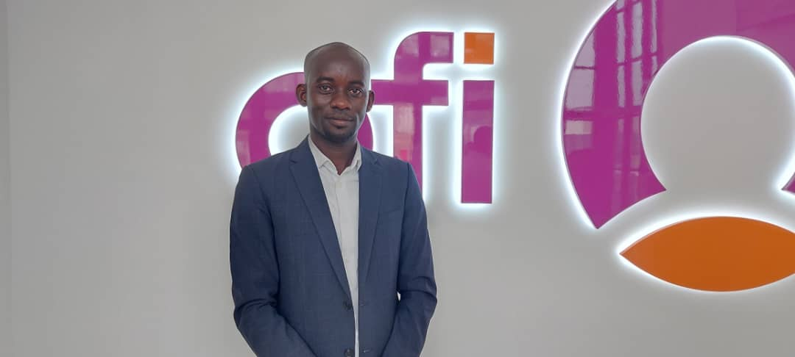
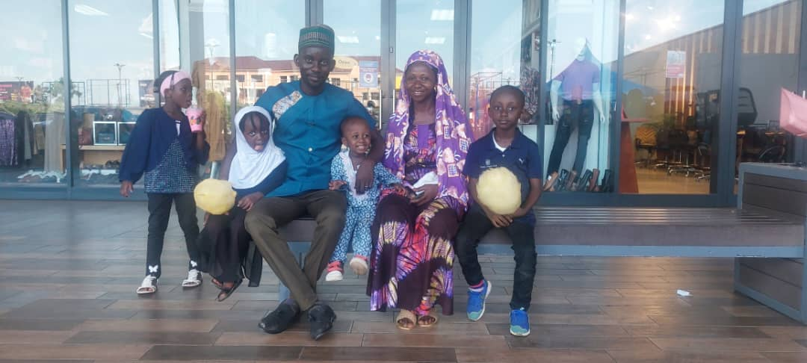
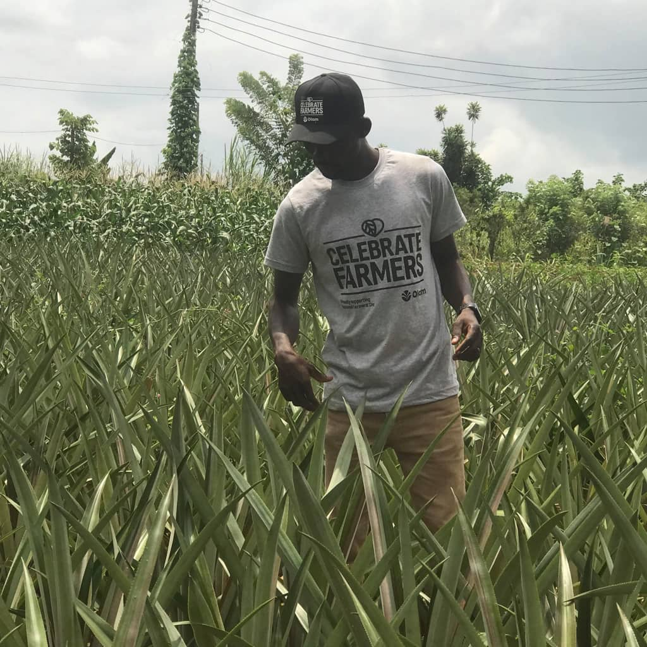
Getting to Know Me
Work
Personal
My role
Community Development and Human Right Manager
Significant others / family members / furry friends in my life
Adam, Hannat, Aaqil, Mubashira and my wife Latifar
Tenure in ofi/Olam
4 years
How I enjoy spending my free time
Bonding with people and reading
Previous companies I have worked at
VSO International
Winrock International
My favorite / comfort food
Fufu
Why I joined ofi/Olam and what keeps me here?
To explore and gain experience from private sector
My favorite song
Heal the world by Micheal Jackson
Zakaria Adams
‘Zack’
A few fun facts about me
I am not perfect and always ready to learn from people.
This is me outside work, doing stuff I enjoy in my life …

